Slide 1
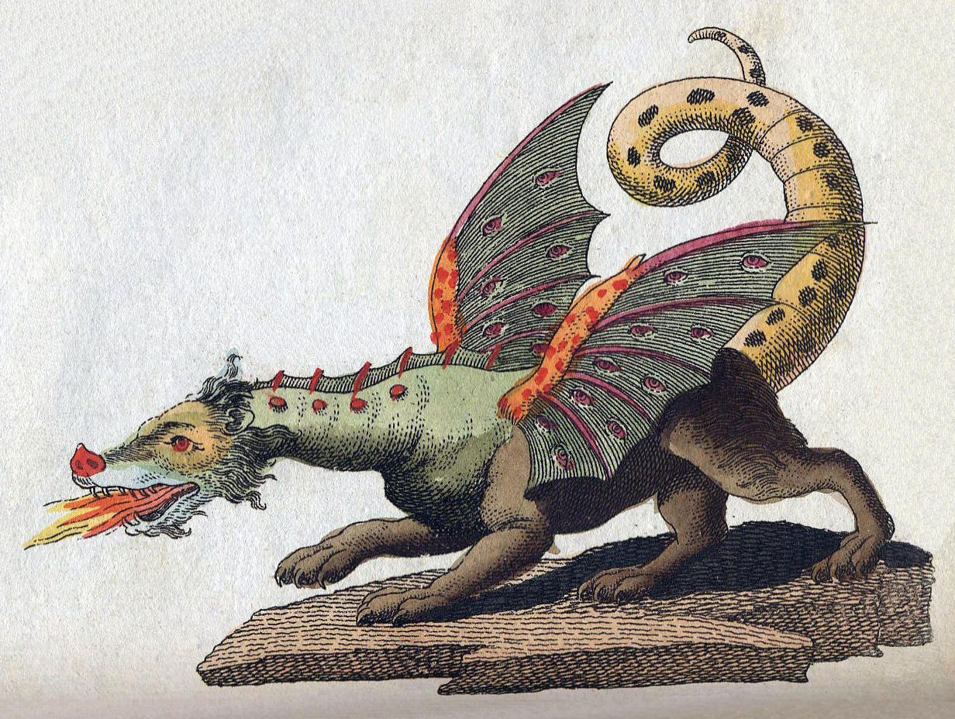
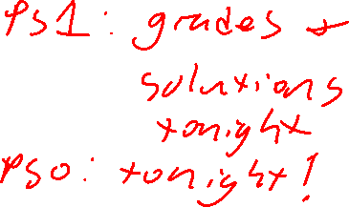

Class 8:
Complexity
University of Virginia
cs3102: Theory of Computation
https://uvatoc.github.io
David Evans, Nathan Brunelle

Slide 2

Last Class
Problem Set 3 is due
Monday (2:59pm)
Syntactic Sugar:
Adding things to make code readable
Doesn't change the computing model
Next:
Complexity
Code running code

Slide 3
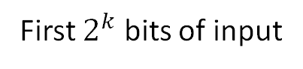
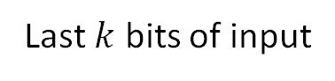
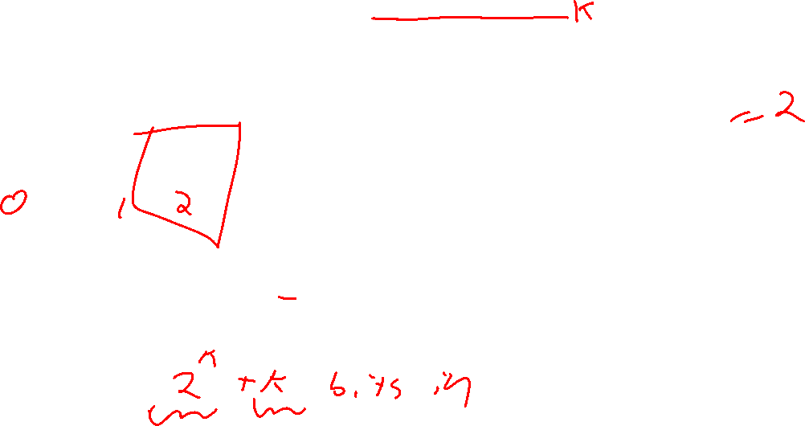
LOOKUP
k=3
x:
i:
0 | 1 | 0 | 0 | 1 | 1 | 1 | 0
0 | 1 | 0
Considered as a bitstring
Considered as an index

Slide 4
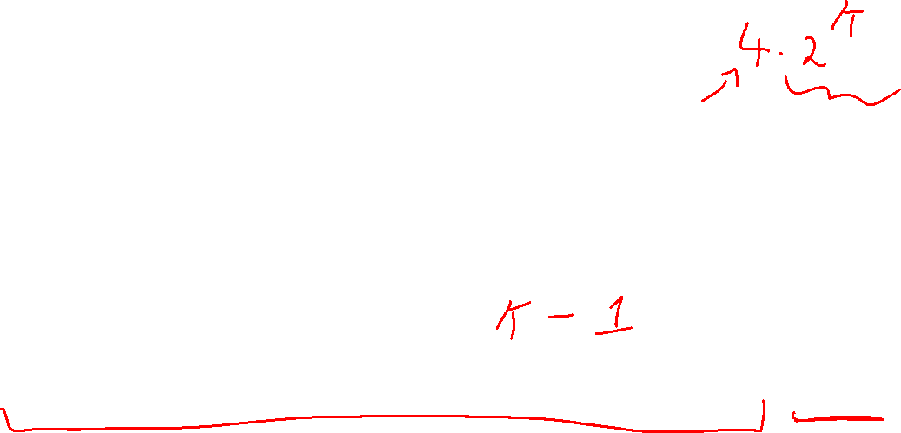
Proof idea
Consider index i
If the first bit of i is 0, then the bit we're looking for is in the first half of x
Do lookup for k-1
x:
i:
0 | 1 | 0 | 0 | 1 | 1 | 1 | 0
0 | 1 | 0
x:
i:
0 | 1 | 0 | 0
1 | 0

Slide 5
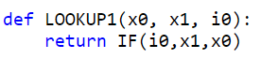
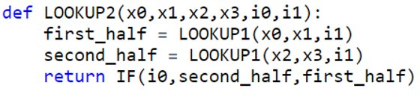
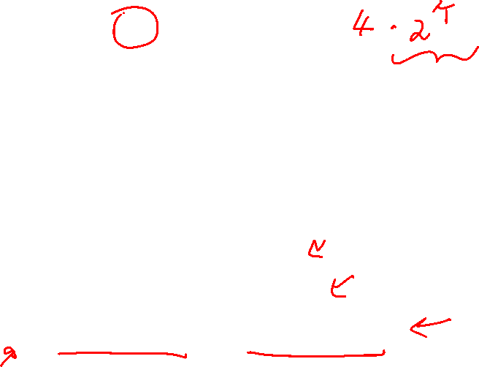
Base Case
Next Step

Slide 6
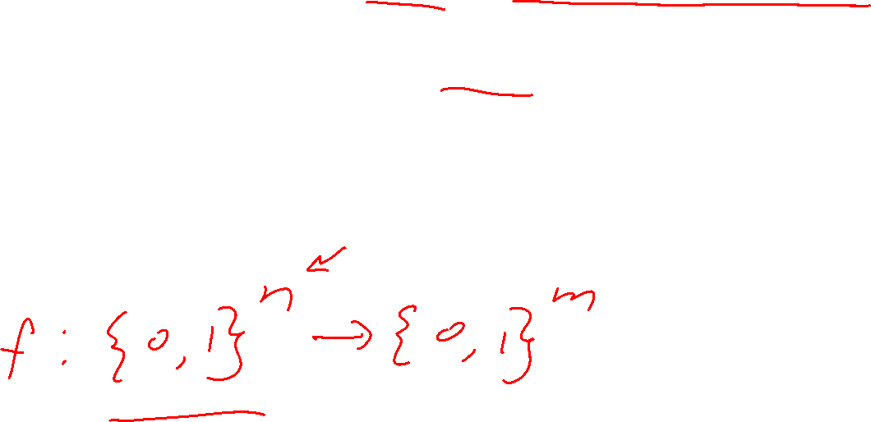
Computing Every Finite Function
Next we'll show that NAND is universal
Any finite function can be computed by some NAND straightline program (equivalently, a NAND circuit)

Slide 7
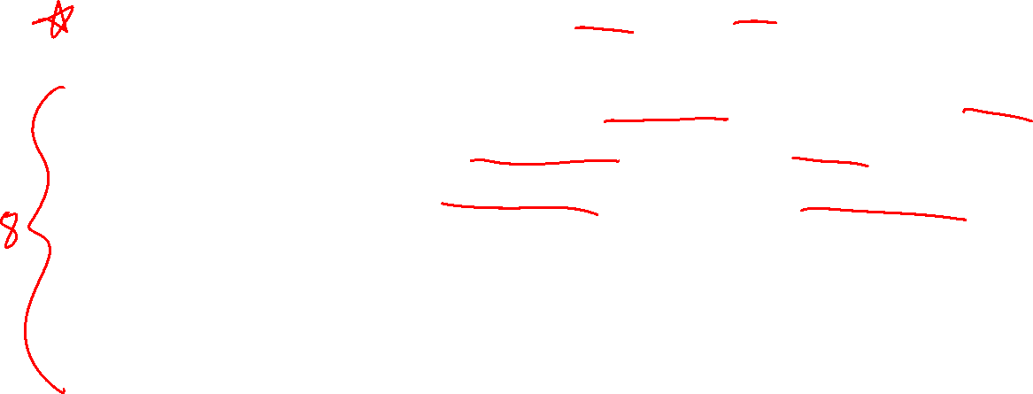
Idea
Input | Output
000 | 0
001 | 0
010 | 1
011 | 0
100 | 1
101 | 1
110 | 0
111 | 0
We will have one variable to represent each possible input. We'll do a lookup with the actual input to select the proper output

Slide 8
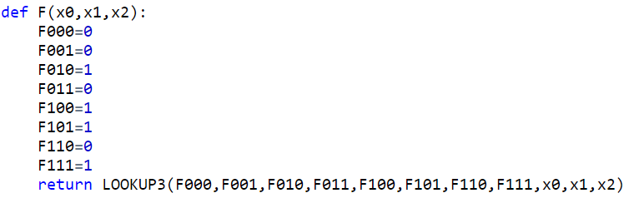
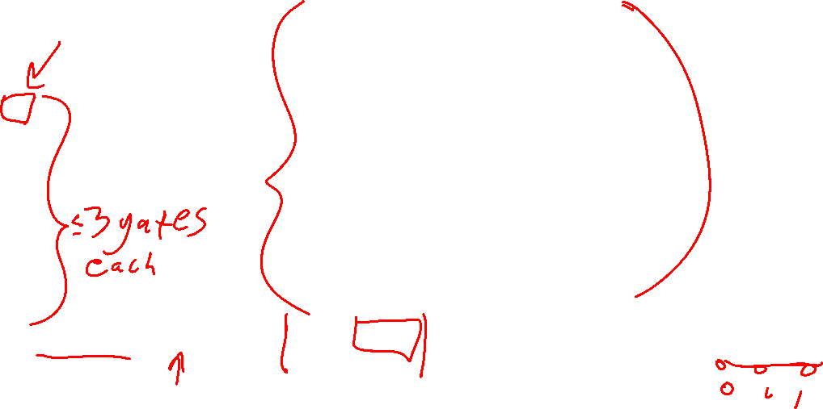
Straightline Code for F
Input | Output
000 | 0
001 | 0
010 | 1
011 | 0
100 | 1
101 | 1
110 | 0
111 | 0

Slide 9
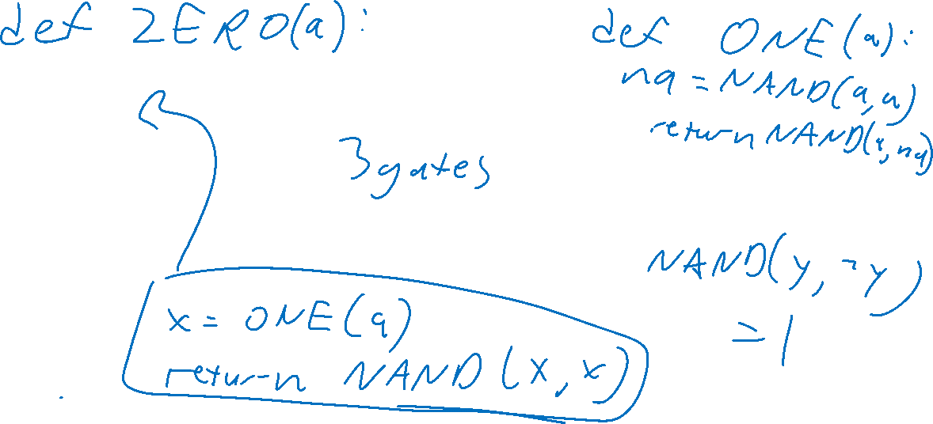
Getting 0 and 1

Slide 10
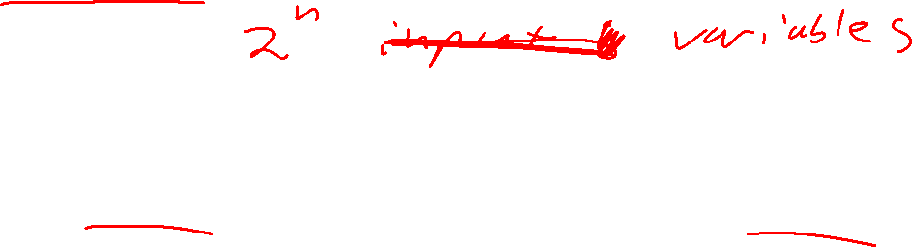
Computing any function
Make a variable to represent each possible input
Assign its value to match the correct output
Use LOOKUP to select the proper output for the given input

Slide 11
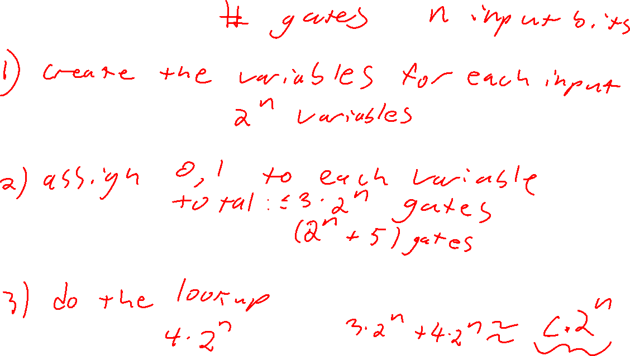

Slide 12
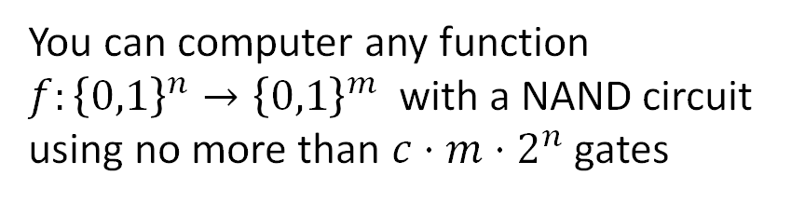
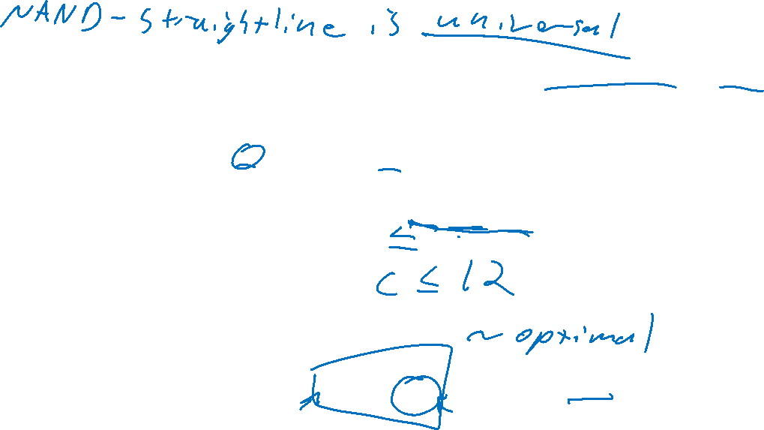
How many gates?
How many gates does this construction take?

Slide 13
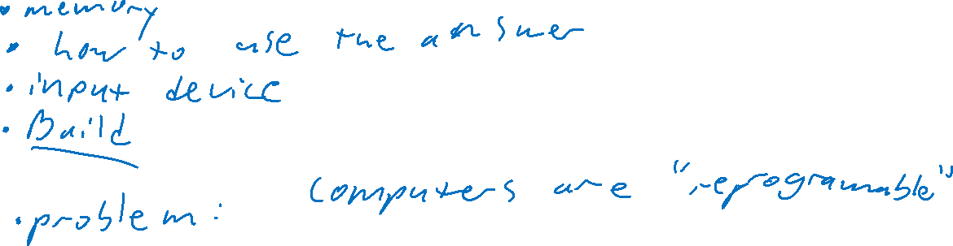
Where do we go from here?
How do I use this knowledge to build a computer?

Slide 14
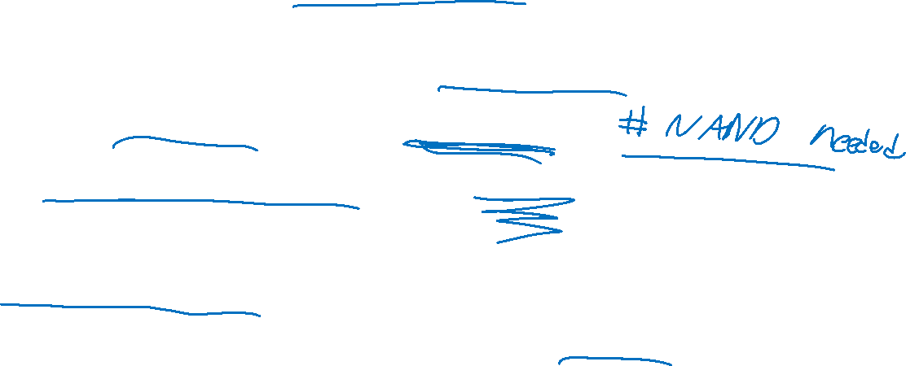
But First
We need to talk about "complexity"
The "complexity" of a function:
Measure of the resources required to compute that function
Complexity Class:
A set of functions defined by a complexity measure

Slide 15
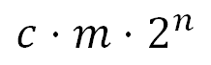
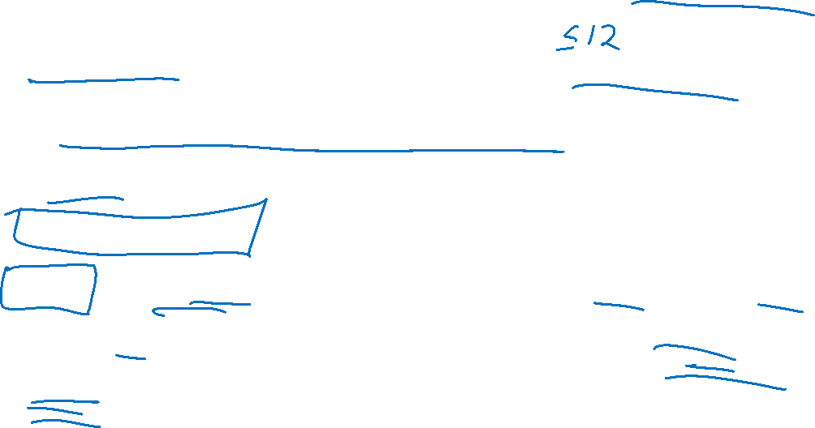
Categorizing Functions by Circuit Size
No functions require more than gates
Some functions require much less
Observation: some functions are more "complicated" than others!
Idea: categorize functions by resources required to implement them using a particular computing model

Slide 16
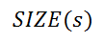
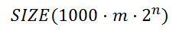
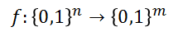
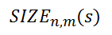
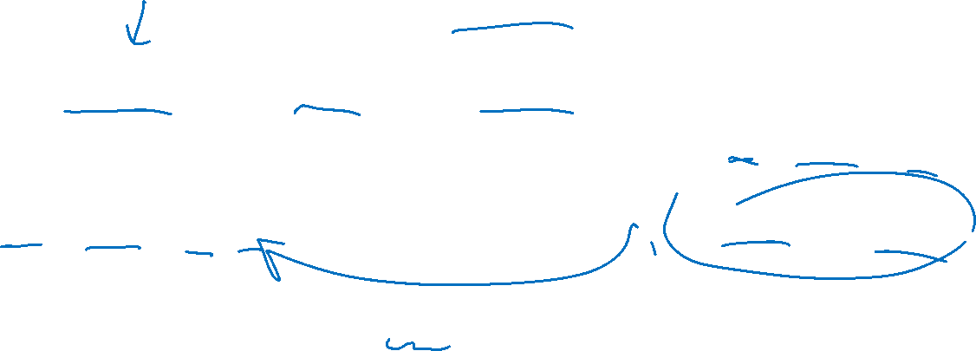
SIZE
The set of all functions that can be implemented by a circuit of at most s NAND gates
TCS also uses: = The set of all n-input, m-output functions that can be implemented with at most s NAND gates
Contains all functions

Slide 17
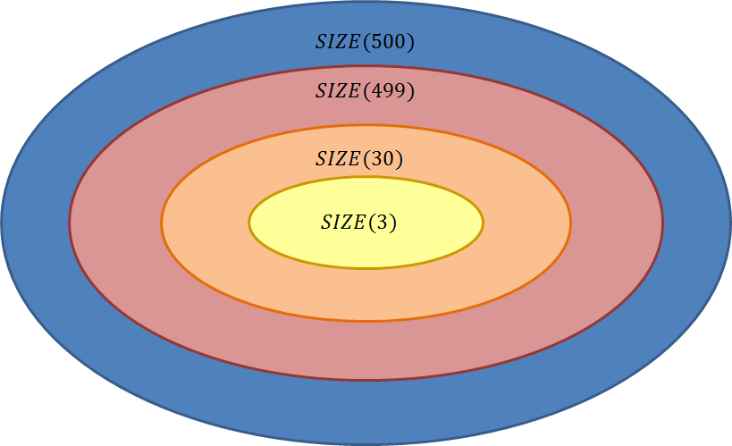
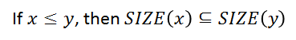
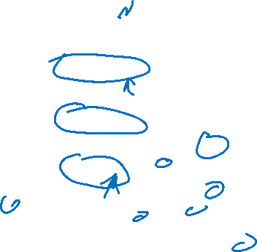
Comparing Categories

Slide 18
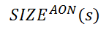
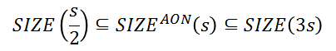
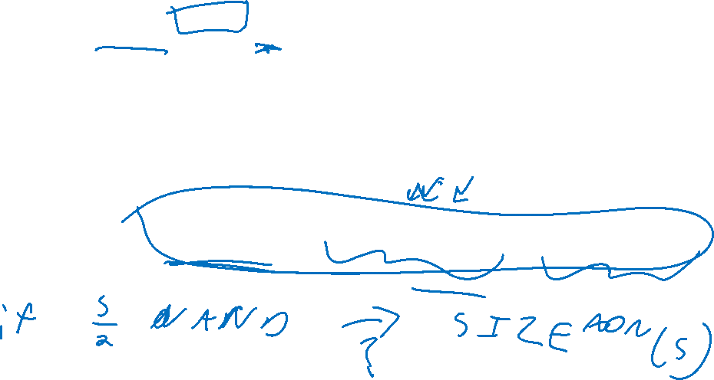
Theorem
Let represent the set of all functions that can be computed using at most s AND/OR/NOT gates

Slide 19
Proof

Slide 20
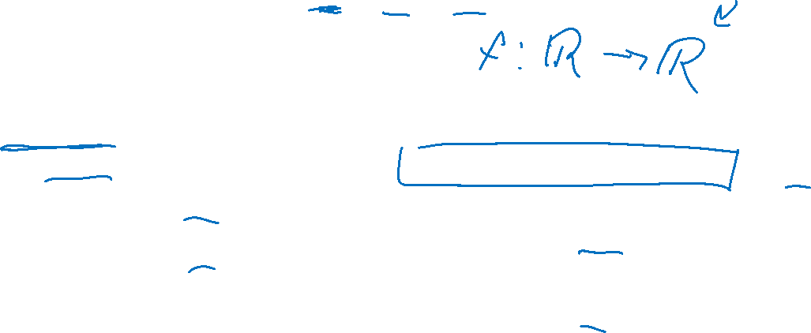
O, Ω, Θ
Groups functions together
Each uses a function as a bound for other functions
O (Big-Oh):
O(f(n)) = the set of all functions "asymptotically upper-bounded" by f
Ω (Big-Omega):
Ω(f(n)) = the set of all functions "asymptotically lower-bounded" by f
Θ (Big-Theta):
Θ(f(n)) = the set of all functions "asymptotically tight-bounded" by f

Slide 21
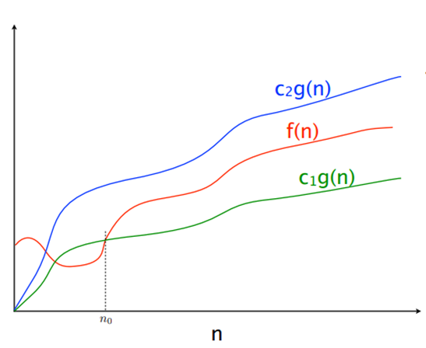
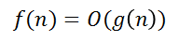
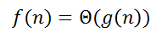
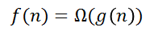
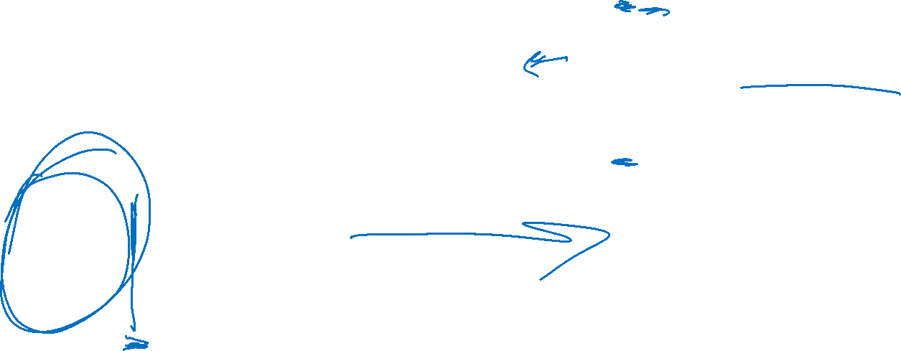

Slide 22
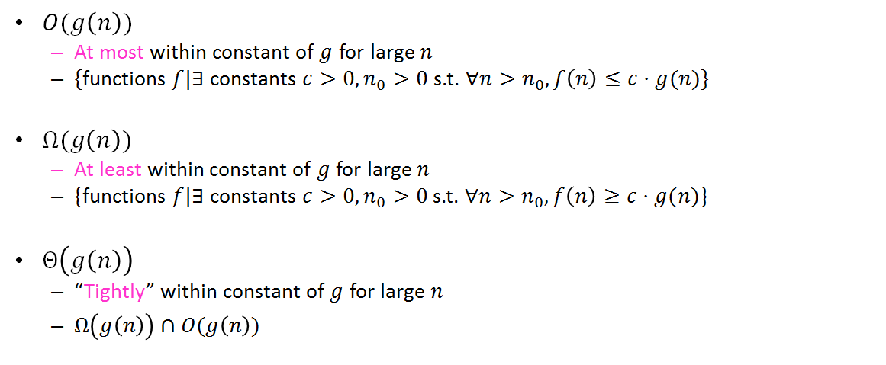
Definitions

Slide 23
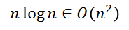
Showing Big-Oh
To show:

Slide 24
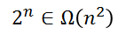
Showing Big-Omega
To Show:

Slide 25
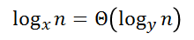
Showing Big-Theta
To Show:

Slide 26
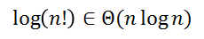
Showing Big-Theta
To Show:

Slide 27
Showing Big-Theta
To Show:

Slide 28
Saying it

Slide 29
Any to Every
Previous theorem:
We can compute ANY k bit function using circuits/straightline programs
What we want:
A machine that can compute EVERY k bit function
How do we do this?:
Define a function that "simulates" programs

Slide 30
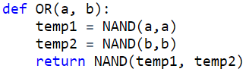
Programs as Bits
To evaluate a program with another program, we need to convert the first program into bits
Number each variable (first n go to input, last m to outputs)
Represent each line as 3 numbers (outvar, in1, in2)
Represent program as (n,m,[Lines])
Variable | Number
a | 0
b | 1
temp1 | 2
temp2 | 3
return | 4
(2,0,0)
(3,1,1)
(4,2,3)
(2,1,[(2,0,0),(3,1,1),(4,2,3)]

Slide 31
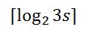
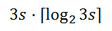
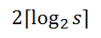
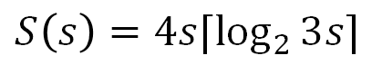
How big is this?
Number each variable
Represent each line as 3 numbers (outvar, in1, in2)
Represent program as (n,m,[Lines])
bits each

Slide 32
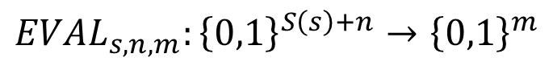
Defining EVAL
Input: bit string representing a program (first S(s) bits) plus input values (remaining n bits)
Output: the result of running the represented program on the provided input, or m 0's if there's a "compile error"

Slide 33
Defining the EVAL function
Representation:
(2,0,0),
(3,1,1),
(4,2,3)
Input:
0, 1
Variable | Value
0
1
2
3
4

Slide 34
Implementing EVAL

Slide 35
GET

Slide 36
UPDATE

Slide 37
How efficient was this?

Slide 38


